Slide 1
MODULE 08 BASIC AERODYNAMICS
LEVEL-2
THEORY OF FLIGHT
Source-EASA MODULE 8
Prepared By – Pranav Thorave
(HAE) PUNE

Slide 2
THEORY OF FLIGHT
Sub-Module 03

Slide 3
RELATIONSHIP BETWEEN LIFT, WEIGHT, THRUST AND DRAG
WEIGHT-
Gravity is the pulling force that tends to draw all bodies toward the center of the earth.
The Center of Gravity (CG) may be considered as a point at which all the weight of the aircraft is concentrated.
If the aircraft were supported at its exact CG, it would balance in any attitude.

Slide 4
Note that the CG is of major importance in an aircraft, for its position has a great bearing upon stability.
The location of the CG is determined by the general design of each particular aircraft.
The designers determine how far the Center of Pressure (CP) will travel.
They then fix the CG forward of the center of pressure for the corresponding flight speed in order to provide an adequate restoring moment to retain flight equilibrium.

Slide 5
Weight has a definite relationship to lift.
This relationship is simple, but important in understanding the aerodynamics of flying. Lift is the upward force on the wing acting perpendicular to the relative wind.
Lift is required to counteract the aircraft's weight (which is caused by the force of gravity acting on the mass of the aircraft).
This weight (gravity) force acts downward through the airplane's CG.
In stabilized level flight, when the lift force is equal to the weight force, the aircraft is in a state of equilibrium and neither gains nor loses altitude.

Slide 6
If lift becomes less than weight, the aircraft loses altitude. When lift is greater than weight, the aircraft gains altitude.

Slide 7
LIFT
The pilot can control lift. Any time the control yoke or stick is moved fore or aft, the Angle of Attack (AOA) is changed.
As the AOA increases, lift increases (all other factors being equal).
When the aircraft reaches the maximum AOA, lift begins to diminish rapidly. This is the stalling AOA, known as Cl-max critical AOA.
The shape of the wing (or rotor) cannot be effective unless it continually keeps "attacking" new air
If an aircraft is to keep flying, the lift-producing airfoil must keep moving

Slide 8
In a helicopter or gyro plane this is accomplished by the rotation of the rotor blades.
For other types of aircraft such as airplanes, weight shift control, or gliders, air must be moving across the lifting surface.
An aircraft cannot continue to travel in level flight at a constant altitude and maintain the same AOA if the velocity is increased.
The lift would increase and the aircraft would climb as a result of the increased lift force. Therefore, to maintain the lift and weight forces in balance, and to keep the aircraft straight and level (not accelerating upward) in a state of equilibrium, as velocity is increased, lift must be decreased.

Slide 9
This is normally accomplished by reducing the AOA by lowering the nose. Conversely, as the aircraft is slowed, the decreasing velocity requires increasing the AOA to maintain lift sufficient to maintain flight. There is, of course, a limit to how far the AOA can be increased, if a stall is to be avoided.
Lift and drag also vary directly with the density of the air.
Density is affected by several factors: pressure, temperature, and humidity.
At an altitude of 18 000 feet, the density of the air has one-half the density of air at sea level.

Slide 10
In order to maintain its lift at a higher altitude, an aircraft must fly at a greater true airspeed for any given AOA. Warm air is less dense than cool air, and moist air is less dense than dry air. Thus, on a hot humid day, an aircraft must be flown at a greater true airspeed for any given AOA than on a cool, dry day

Slide 11
If the density factor is decreased and the total lift must equal the total weight to remain in flight, it follows that one of the other factors must be increased. The factor usually increased is the airspeed or the AOA, because these are controlled directly by the pilot.
Lift varies directly with the wing area, provided there is no change in the wing's planform.

Slide 12
Two major aerodynamic factors from the pilot's viewpoint are lift and velocity because they can be controlled readily and accurately.
Of course, the pilot can also control density by adjusting the altitude and can control wing area if the aircraft happens to have flaps of the type that enlarge wing area.

Slide 13
However, for most situations, the pilot controls lift and velocity to maneuver an aircraft. For instance, in straight-and-level flight, cruising along at a constant altitude, altitude is maintained by adjusting lift to match the aircraft's velocity or cruise airspeed, while maintaining a state of equilibrium in which lift equals weight.
In an approach to landing, when the pilot wishes to land as slowly as practical, it is necessary to increase lift to near maximum to maintain lift equal to the weight of the aircraft.

Slide 14
THRUST AND DRAG
Thrust has a definite relationship with drag. These relationships are quite simple, but very important in understanding the aerodynamics of flying.
Wing area is measured in square feet and includes the part blanked out by the fuselage
Wing area is adequately described as the area of the shadow cast by the wing at high noon.
Tests show that lift and drag forces acting on a wing are roughly proportional to the wing area. This means that if the wing area is doubled, all other variables remaining the same, the lift and drag created by the wing is doubled. If the area is tripled, lift and drag are tripled.

Slide 15
Thrust is derived from jet propulsion or from a propeller and engine combination. Jet propulsion theory is based on Newton's third law of motion.
The turbine engine causes a mass of air to be moved backward at high velocity causing a reaction that moves the aircraft forward.
In a propeller/engine combination, the propeller is actually two or more revolving airfoils mounted on a horizontal shaft.

Slide 16
In order to maintain a steady speed, thrust and drag must remain equal, just as lift and weight must be equal for steady, horizontal flight. If the revolutions per minute (rpm) of the engine is reduced, the thrust is lessened, and the aircraft slows down.
As long as the thrust is less than the drag, the aircraft travels more and more slowly until its speed is insufficient to support it in the air
if the rpm of the engine is increased, thrust becomes greater than drag, and the speed of the aircraft increases. As long as the thrust continues to be greater than the drag, the aircraft continues to accelerate. When drag equals thrust, the aircraft flies at a steady speed.

Slide 17
STEADY STATE FLIGHT
The above paragraphs describes what is known as steady state flight. When thrust equals drag, and lift equals weight (gravity), the aircraft is said to be flying in a state of equilibrium.

Slide 18
GLIDE RATIO
The glide ratio of an airplane is the distance the airplane will, with power off, travel forward in relation to the altitude it loses.
For instance, if an airplane travels 10 000 feet forward while descending 1 000 feet, its glide ratio is said to be 10 to 1.
The glide ratio is affected by all four fundamental forces that act on an airplane (weight, lift, drag, and thrust).
If all factors affecting the airplane are constant, the glide ratio will be constant.

Slide 19
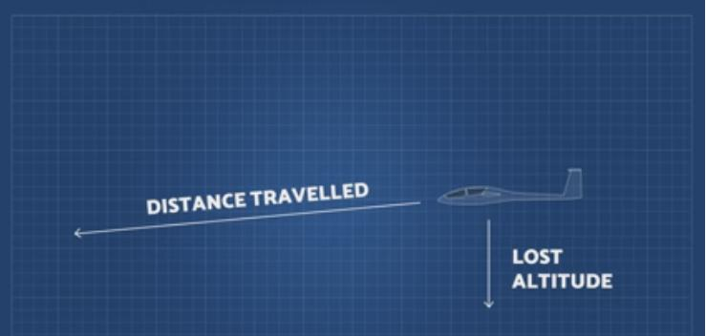

Slide 20
With a tailwind, the airplane will glide farther because of the higher groundspeed. Conversely, with a headwind the airplane will not glide as far because of the slower groundspeed.
Variations in weight do not affect the glide angle provided the pilot uses the correct airspeed. Since it is the Lift Over Drag (L/D) ratio that determines the distance the airplane can glide, weight will not affect the distance.

Slide 21
The glide ratio is based only on the relationship of the aerodynamic forces acting on the airplane.
The only effect weight has is to vary the time the airplane will glide.
The heavier the airplane the higher the airspeed must be to obtain the same glide ratio. For example, if two airplanes having the same L/D ratio, but different weights, start a glide from the same altitude, the heavier airplane gliding at a higher airspeed will arrive at the same touchdown point in a shorter time.
Both airplanes will cover the same distance, only the lighter airplane will take a longer time.

Slide 22
Under various flight conditions, the drag factor may change through the operation of the landing gear and/or flaps.
When the landing gear or the flaps are extended, drag increases and the airspeed will decrease unless the pitch attitude is lowered.
As the pitch is lowered, the glidepath steepens and reduces the distance traveled. With the power off, a windmilling propeller also creates considerable drag, thereby retarding the airplane's forward movement.

Slide 23
Although the propeller thrust of the airplane is normally dependent on the power output of the engine, the throttle is in the closed position during a glide so the thrust is constant.
Since power is not used during a glide or power-off approach, the pitch attitude must be adjusted as necessary to maintain a constant airspeed.

Slide 24
Any change in the gliding airspeed will result in a proportionate change in glide ratio. Any speed, other than the best glide speed, results in more drag. Therefore, as the glide airspeed is reduced or increased from the optimum or best glide speed, the glide ratio is also changed. When descending at a speed below the best glide speed, induced drag increases. When descending at a speed above best glide speed, parasite drag increases. In either case, the rate of descent will increase.

Slide 25
The pilot must never attempt to "stretch" a glide by applying back-elevator pressure and reducing the airspeed below the airplane's recommended best glide speed. Attempts to stretch a glide will invariably result in an increase in the rate and angle of descent and may precipitate an inadvertent stall.

Slide 26
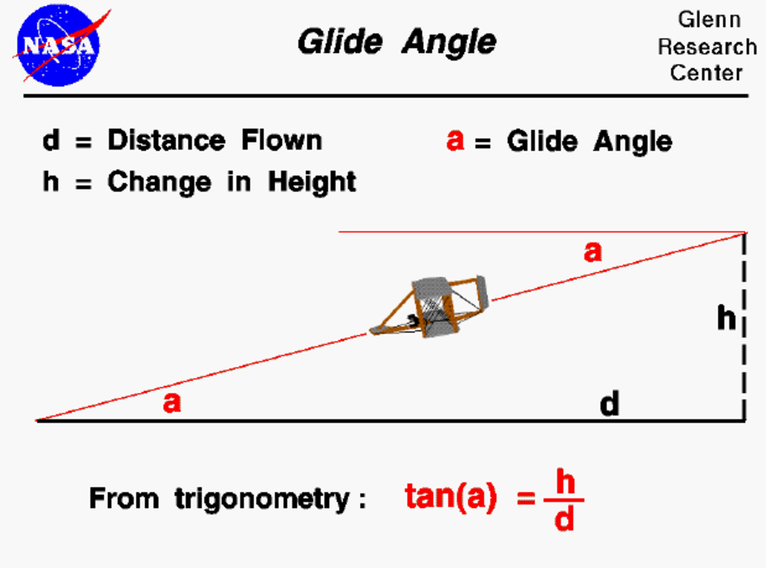
Gliding Angle
The gliding angle is the angle between the ground and the flight path of an airplane or glider. It's the smallest angle at which an aircraft will glide to the ground in still air.
Or
The angle between the plane of the horizon and the path of a glider or airplane

Slide 27
Key Factors Influencing Glide Angle
Lift-to-Drag (L/D) Ratio:
The glide angle is inversely proportional to the L/D ratio:
Higher L/D ratios result in lower glide angles.
Airplane Weight:
The glide angle in still air remains constant regardless of weight, though the speed at which the glide occurs changes with weight.
Atmospheric Conditions:
Wind and turbulence can affect the apparent glide angle relative to the ground.
Aircraft Configuration:
The design of the wings and the overall aerodynamic efficiency of the aircraft play a critical role.

Slide 28
Applications of Glide Angle
Emergency Landings :
Pilots use the glide angle to estimate how far they can travel horizontally for a safe landing during engine failure.
Aircraft Design :
Engineers aim to design aircraft with optimized glide angles for better fuel efficiency or gliding capabilities.

Slide 29
POLAR CURVE
A polar curve is a graph which contrasts the sink rate of an aircraft with its horizontal speed. It is used mainly to illustrate performance of a glider.
sink rate is the amount of distance/time the aircraft sinks from final position to reach touchdown on the runway threshold. usually measured in feet/second.
Knowing the best speed to fly is important in exploiting the performance of a glider.

Slide 30
Two of the key measures of a glider's performance are its minimum sink rate and its best glide ratio, also known as the best glide angle. These occur at different speeds. Knowing these speeds is important for efficient cross country flying.
In still air the polar curve shows that flying at the minimum sink speed enables the pilot to stay airborne for as long as possible and to climb as quickly as possible. But at this speed, the glider will not travel as far as if it flew at the speed for the best glide.
When in sinking air, the polar curve shows that best speed to fly depends on the rate that the air is descending.

Slide 31
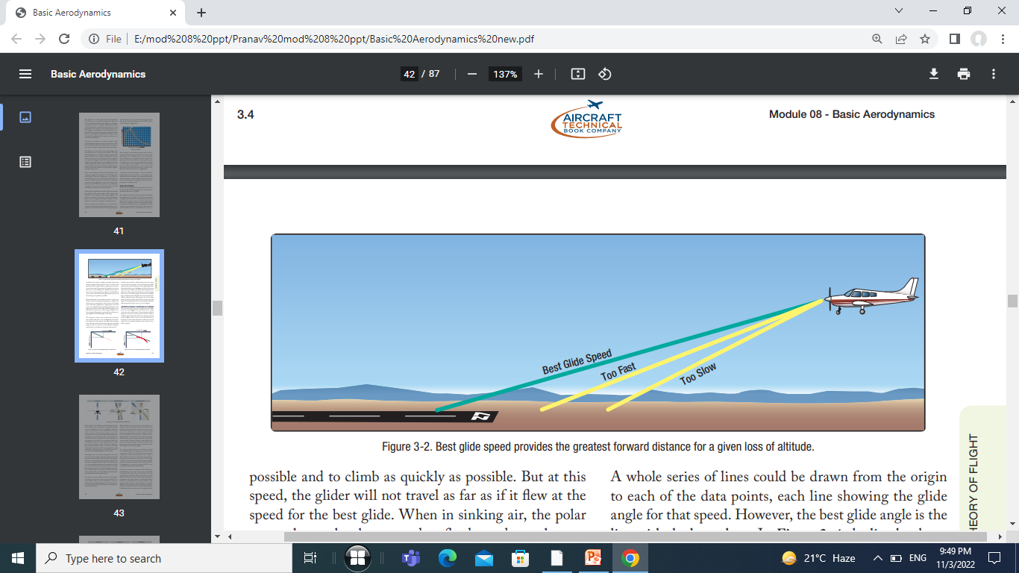

Slide 32
By measuring the rate of sink at various air speeds a set of data can be accumulated and plotted on a graph.
The points can be connected by a line known as the polar curve.
Each type of glider has a unique polar curve.
The curve can be significantly degraded with debris such as bugs, dirt, and rain on the wing.
Published polar curves will often be shown for a clean wing in addition to a dirty wing with bug splats represented by small pieces of tape applied to the leading edge of the wing.

Slide 33
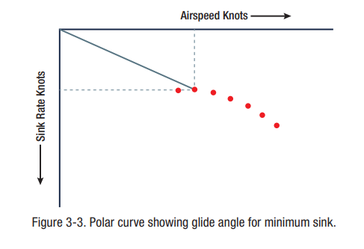
The origin for a polar curve is where the air speed is zero and the sink rate is zero.
In Figure a line has been drawn from the origin to the point with minimum sink.

Slide 34
The slope of the line from the origin gives the glide angle, because it is the ratio of the distance along the airspeed axis to the distance along the sink rate axis.
A whole series of lines could be drawn from the origin to each of the data points, each line showing the glide angle for that speed.
However, the best glide angle is the line with the least slope.

Slide 35
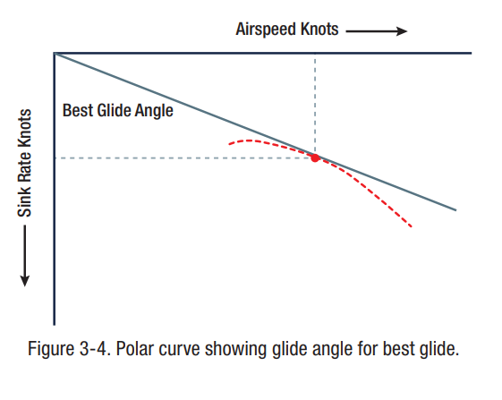
In Figure the line has been drawn from the origin to the point representing the best glide ratio.

Slide 36
The air speed and sink rate at the best glide ratio can be read off the graph. Note that the best glide ratio is shallower than the glide ratio for minimum sink.
All the other lines from the origin to the various data points would be steeper than the line of the best glide angle.
Consequently, the line for the best glide angle will only just graze the polar curve, e.g. it is a tangent.

Slide 37
AERODYNAMIC FORCES IN TURNS
For an aircraft to turn, a force is required to deflect the aircraft towards the centre of the turn. This is known as the centripetal force and arises when an aircraft is banked, as the total lift force is tilted, splitting the lift force into two components
The horizontal component of lift creates the centripetal force towards the centre of the turn, with the vertical component of lift supporting the weight of the aircraf

Slide 38
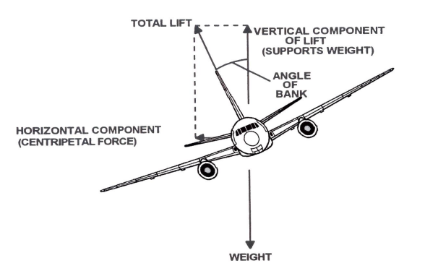

Slide 39
Turning an aircraft
To perform a turn, the ailerons are used to increase the lift over one wing and maintain the desired angle of bank.
In this sort of manoeuvre as the aircraft banks, the vertical component of the lift force decreases, as the angle of bank increases, which leads to a loss in altitude and the aircraft sideslipping.
In order to keep the aircraft level in the turn therefore, as the aircraft is banked the control column must be moved rearwards to increase the wings angle of attack and increase the total lift produced by the wings to recover the lost lift and balance the weight force

Slide 40
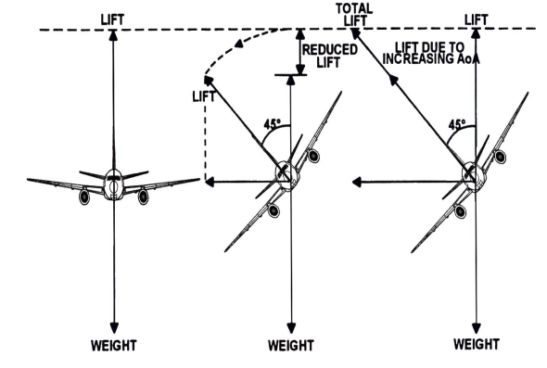

Slide 41
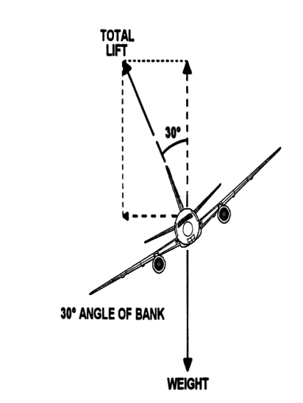
The angle between the wings and the horizon, as viewed from the rear of the airplane is called angle of bank.

Slide 42
If the aircraft were in a bank it would be apparent that lift did not act directly opposite to the weight, rather it now acts in the direction of the bank.
A basic truth about turns: when the aircraft banks, lift acts inward toward the center of the turn, as well as upward.
Newton's First Law of Motion, the Law of Inertia, states that an object at rest or moving in a straight line remains at rest or continues to move in a straight line until acted on by some other force.

Slide 43
The force of lift during a turn is separated into two components at right angles to each other.
One component, which acts vertically and opposite to the weight (gravity), is called the "vertical component of lift."
The other, which acts horizontally toward the center of the turn, is called the "horizontal component of lift," or centripetal force.
The horizontal component of lift is the force that pulls the aircraft from a straight flight path to make it turn.

Slide 44
Centrifugal force is the "equal and opposite reaction" of the aircraft to the change in direction and acts equal and opposite to the horizontal component of lift. This explains why, in a correctly executed turn, the force that turns the aircraft is not supplied by the rudder.
The rudder is used to correct any deviation between the straight track of the nose and tail of the aircraft.
A good turn is one in which the nose and tail of the aircraft track along the same path.
If no rudder is used in a turn, the nose of the aircraft yaws to the outside of the turn. The rudder is used to bring the nose back in line with the relative wind.

Slide 45
In turning flight, the number of degrees of heading change per unit of time (usually measured in seconds) is referred to as the rate of turn.
As the angle of bank is increased, the horizontal component of lift increases, thereby increasing the Rate of Turn (ROT).
Consequently, at any given airspeed, ROT can be controlled by adjusting the angle of bank.
To provide a vertical component of lift sufficient to hold altitude in a level turn, an increase in the AOA is required.

Slide 46
Since the drag of the airfoil is directly proportional to its AOA, induced drag increases as the lift is increased.
This, in turn, causes a loss of airspeed in proportion to the angle of bank. A small angle of bank results in a small reduction in airspeed while a large angle of bank results in a large reduction in airspeed.
Additional thrust (power) must be applied to prevent a reduction in airspeed in level turns. The required amount of additional thrust is proportional to the angle of bank.

Slide 47
In slipping turns the nose of the aircraft is yawed towards the outside of a turn. In skidding turns the nose of the aircraft is yawed towards the inside of a turn. Both turns are considered “uncoordinated” because the horizontal lift component does not equal the centrifugal force of the aircraft.
Slipping turns occur when the nose is yawed outside of the turn. This is caused by either too little rudder in the direction of the turn, or even the use of opposite rudder (adverse yaw).
Skidding turns occur when the nose is yawed inside the turn. This is caused by either too much rudder in the direction of the turn.

Slide 48
INFLUENCE OF LOAD
STALLS –
An aircraft stall results from a rapid decrease in lift caused by the separation of airflow from the wing's surface brought on by exceeding the critical AOA.
A stall can occur at any pitch attitude or airspeed. Stalls are one of the most misunderstood areas of aerodynamics because pilots often believe an airfoil stops producing lift when it stalls.
In a stall, the wing does not totally stop producing lift. Rather, it can not generate adequate lift to sustain level flight.

Slide 49
Since the Cl increases with an increase in AOA, at some point the Cl peaks and then begins to drop off. This peak is called the Cl-max.
In most straight-wing aircraft, the wing is designed to stall the wing root first. The wing root reaches its critical AOA first making the stall progress outward toward the wingtip.
By having the wing root stall first, aileron effectiveness is maintained at the wingtips, maintaining controllability of the aircraft.
Various design methods are used to achieve the stalling of the wing root first. In one design, the wing is "twisted" to a higher AOA at the wing root.

Slide 50
The wing never completely stops producing lift in a stalled condition. If it did, the aircraft would fall to the Earth.
Most training aircraft are designed for the nose of the aircraft to drop during a stall, reducing the AOA and "unstalling" the wing.
The "nose-down" tendency is due to the CL being aft of the CG.
The CG range is very important when it comes to stall recovery characteristics.

Slide 51
The stalling speed of a particular aircraft is not a fixed value for all flight situations, but a given aircraft always stalls at the same AOA regardless of airspeed, weight, load factor, or density altitude.
Each aircraft has a particular AOA where the airflow separates from the upper surface of the wing and the stall occurs.
This critical AOA varies from 16° to 20° depending on the aircraft's design. But each aircraft has only one specific AOA where the stall occurs

Slide 52
There are three flight situations in which the critical AOA can be exceeded: low speed, high speed, and turning.
The aircraft can be stalled in straight-and-level flight by flying too slowly.
As the airspeed decreases, the AOA must be increased to retain the lift required for maintaining altitude. The lower the airspeed becomes, the more the AOA must be increased. Eventually, an AOA is reached which results in the wing not producing enough lift to support the aircraft which starts settling.
If the airspeed is reduced further, the aircraft stalls, since the AOA has exceeded the critical angle and the airflow over the wing is disrupted

Slide 53
The stalling speed of an aircraft is also higher in a level turn than in straight-and-level flight.
Centrifugal force is added to the aircraft's weight and the wing must produce sufficient additional lift to counterbalance the load imposed by the combination of centrifugal force and weight.
In a turn, the necessary additional lift is acquired by applying back pressure to the elevator control.
This increases the wing's AOA, and results in increased lift. The AOA must increase as the bank angle increases to counteract the increasing load caused by centrifugal force. If at any time during a turn the AOA becomes excessive, the aircraft stalls.

Slide 54
To balance the aircraft aerodynamically, the CL is normally located aft of the CG. Although this makes the aircraft inherently nose-heavy, downwash on the horizontal stabilizer counteracts this condition.
At the point of stall, when the upward force of the wing's lift and the downward tail force cease, an unbalanced condition exists.
This allows the aircraft to pitch down abruptly, rotating about its CG. During this nose-down attitude, the AOA decreases and the airspeed again increases.
The smooth flow of air over the wing begins again, lift returns, and the aircraft is again flying. Considerable altitude may be lost before this cycle is complete.

Slide 55
airfoil shape and degradation of that shape must also be considered in a discussion of stalls.
Combined with the increased drag and reduced lift generation due to the accumulation of ice, snow or frost on the aircraft lifting surfaces, a stall may occur at a lower angle of attack than normal or at a higher speed.

Slide 56
FLIGHT ENVELOPE
A flight envelope, performance envelope or service envelope refers to capabilities and limitations of a particular aircraft design package.

Slide 57
STRUCTURAL LIMITATIONS
Load Factors-
In aerodynamics, load factor is the ratio of the maximum load an aircraft can sustain to the gross weight of the aircraft.
The aircraft gross weight (also known as the all-up weight and abbreviated AUW) is the total aircraft weight at any moment during the flight or ground operation.

Slide 58
The load factor is measured in Gs (acceleration of gravity).
Any force applied to an aircraft to deflect its flight from a straight line produces a stress on its structure, and the amount of this force is the load factor.
For example, a load factor of 3 means the total load on an aircraft's structure is three times its gross weight.
Since load factors are expressed in terms of Gs, a load factor of 3 may be spoken of as 3 Gs, or a load factor of 4 as 4 Gs.

Slide 59
Load factors are important for two reasons:
1. It is possible for a pilot to impose a dangerous overload on the aircraft structures.
2. An increased load factor increases the stalling speed and makes stalls possible at seemingly safe flight speeds

Slide 60
Load Factors in Aircraft Design
"How strong should an aircraft be?“ is determined largely by the use to which the aircraft is subjected. This is a difficult problem because the maximum possible loads are much too high for use in efficient design.
It is true that any pilot can make a very hard landing or an extremely sharp pull up from a dive, which would result in abnormal loads.

Slide 61
Although certification requirements typically require the aircraft structure be capable of supporting one and one-half times these limit load factors without failure, it is accepted that parts of the aircraft may bend or twist under these loads and that some structural damage may occur.
This 1.5 load limit factor is called the "factor of safety" and provides, to some extent, for loads higher than those expected under normal and reasonable operation.

Slide 62
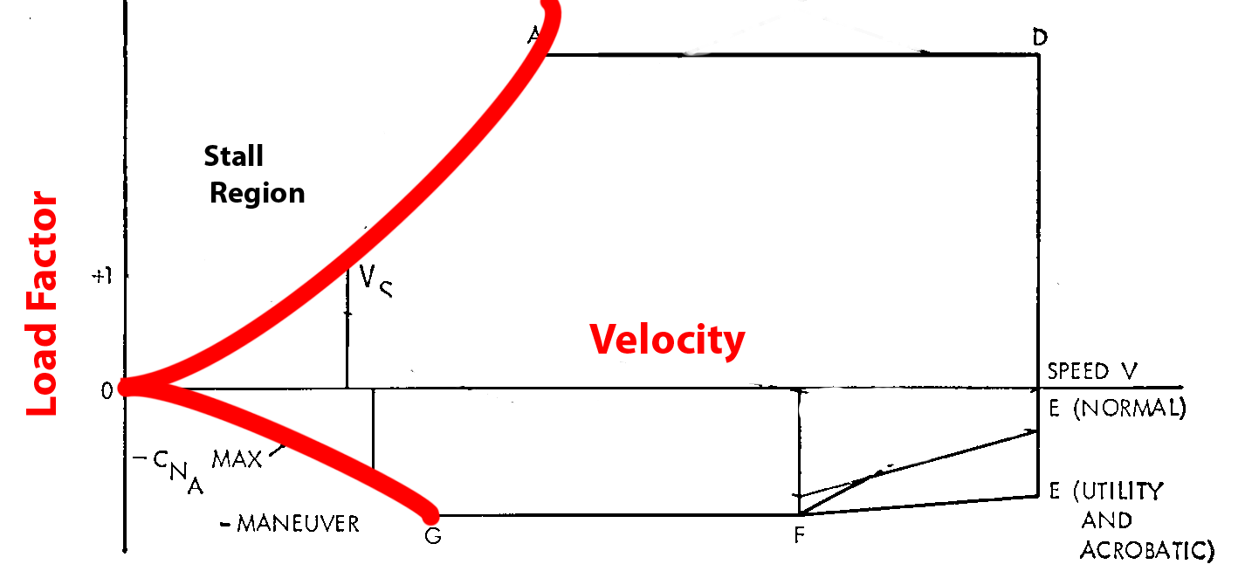
FLIGHT ENVELOPE
Load factor is ratio of aircraft lift to its weight
Flight envelope discribe aerodynamic and structural limitation of aircraft
Pilot fly the aircraft based on the envelope

Slide 63
An entirely different situation exists in aircraft design with maneuvering load factors. It is necessary to discuss this matter separately with respect to:
aircraft designed in accordance with the category system (e.g., normal, utility, acrobatic); and
(2) older designs built according to requirements which did not provide for operational categories

Slide 64
Aircraft designed under the category system are readily identified by a placard in the flight deck, which states the operational category (or categories) in which the aircraft is certificated.
The maximum safe load factors (limit load factors) specified for aircraft in the various categories are:
Typical Category Limit Load Factors:
Normal - 3.8 to – 1.52
Utility (mild acrobatics, including spins)
4.4 to – 1.76
Acrobatic 6.0 to – 3.00

Slide 65
For aircraft with gross weight of more than 4 000 pounds, the limit load factor is reduced.
For aircraft specification calculation in aeronautics, limit load (LL) is the maximum load factor authorized during flight
limit load is LL = LLF x W
LL = limit load.
LLF = limit load factor
W = weight of the aircraft.

Slide 66
HIGH SPEED FLIGHT
SUBSONIC VS SUPERSONIC FLOW :
At speeds of approximately 260 knots, air can be considered incompressible in that, at a fixed altitude, its density remains nearly constant while its pressure varies.
Under this assumption, air acts the same as water and is classified as a fluid.
Subsonic aerodynamic theory also assumes the effects of viscosity (the property of a fluid that tends to prevent motion of one part of the fluid with respect to another) are negligible, and classifies air as an ideal fluid, conforming to the principles of ideal-fluid aerodynamics such as continuity, Bernoulli's principle, and circulation.

Slide 67
In reality, air is compressible and viscous.
While the effects of these properties are negligible at low speeds.
During flight, a wing produces lift by accelerating the airflow over the upper surface.
At some extreme AOAs, in some aircraft, the speed of the air over the top surface of the wing may be double the aircraft's speed.
It is therefore entirely possible to have both supersonic and subsonic airflow on an aircraft at the same time.

Slide 68
SPEED RANGES
The speed of sound varies with temperature.
Under standard temperature conditions of 15°C, the speed of sound at sea level is 661 knots.
At 40 000 feet, where the temperature is –55°C, the speed of sound decreases to 574 knots.
In high-speed flight and/or high-altitude flight, the measurement of speed is expressed in terms of a "Mach number“
"Mach number"—the ratio of the true airspeed of the aircraft to the speed of sound in the same atmospheric conditions.

Slide 69
Subsonic—Mach numbers below 0.75
Transonic—Mach numbers from 0.75 to 1.20
Supersonic—Mach numbers from 1.20 to 5.00
Hypersonic—Mach numbers above 5.00
While flights in the transonic and supersonic ranges are common occurrences for military aircraft, civilian jet aircraft normally operate in a cruise speed range of Mach 0.7 to Mach 0.90.

Slide 70
Mach 1.0 is termed "critical Mach number" or "Mach Crit.
Critical mach number is the boundary between subsonic and transonic flight and is largely dependent on the wing and airfoil design.
Shock waves, buffet, and airflow separation take place above critical Mach number.
A jet aircraft typically is most efficient when cruising at or near its critical Mach number.

Slide 71
At speeds 5–10 percent above the critical Mach number, compressibility effects begin. Drag begins to rise sharply. Associated with the "drag rise" are buffet, trim and stability changes, and a decrease in control surface effectiveness. This is the point of "drag divergence."

Slide 72
VMO/MMO is defined as the maximum operating limit speed.
VMO:-
VMO is expressed in Knots Calibrated Airspeed (KCAS)
The VMO limit is usually associated with operations at lower altitudes and deals with structural loads and flutter.
At lower altitudes, structural loads and flutter are of concern
MMO:-
while MMO is expressed in Mach number.
The MMO limit is associated with operations at higher altitudes and is usually more concerned with compressibility effects and flutter.
at higher altitudes, compressibility effects and flutter are of concern.

Slide 73
THANK YOU
Prepared By :
Mr. Pranav Thorave
Hindustan Aerospace And Engineering Pune.

